Slide 1
Overview of programming

Slide 2
Content
What is Overview about?
Why programming
Machine code
Assembly language
High level programming language
Programming Paradigms
Common structure of programming
General workflow
Different area of programming

Slide 3
What is Overview About?
Give you a feel of how it look
What it does
Really abstract idea
How it interact with other’s component
Some analogy

Slide 4
Why programming?
It allow us to automated repetitive task
It can do almost everything
Programming is involved in your life in some way
A chance of creating something yourself
Allow us to have more free
Make Utopia a possibility

Slide 5

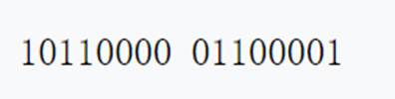
Machine Language
It is directly executed by the CPU
processor family has its own machine code instruction set
uses - low level debugging, program patching, assembly language disassembly
Analogy – Atom of computer language
Why almost nobody use it
Reading it will give you a headache
Writing it will give you a headache
There is much better alternative
It’s like looking at DNA code

Slide 6
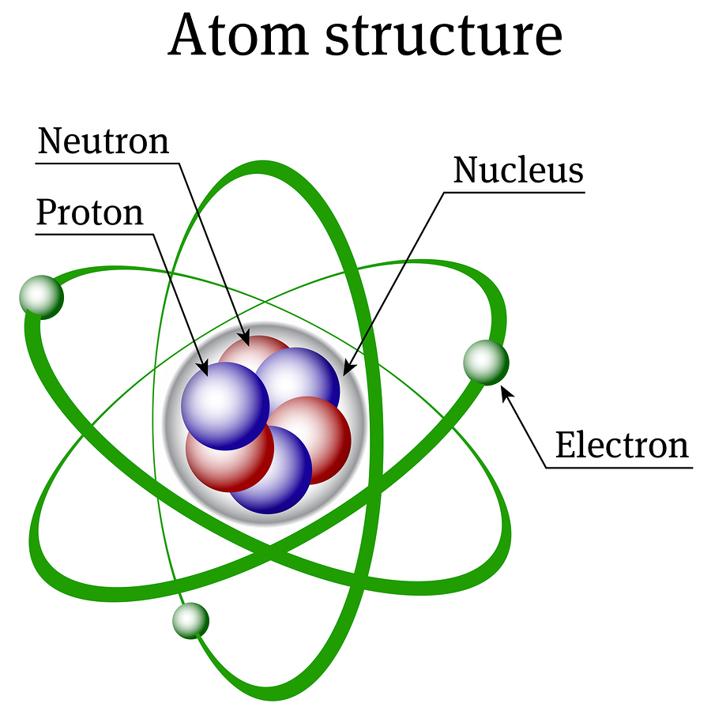

assembly language
specific to a particular computer architecture
converted into executable machine code by an assembler
uses a mnemonic to represent each low-level machine instruction
Analogy – still a atom but drawn more prettier and with label
Uses:
optimize for speed or optimize for size
embedded programming
Computer viruses, bootloader, device driver
Reverse engineering

